Slide 1
Complete Flow Chart - Library
Version 1
ONLL w/ losses
ONLL w/o losses
+5, -0
+10, -10
+0, -2
+0, -5
+5, -0
+10, -0
+20, -0
+0, -0
OLL
ONLL w/ and w/o losses
+5, -0
+20, -0
+10, -0
+5, -10
+0, -20
+5, -5
Lib

Slide 2
Complete Flow Chart - Office
Version 1
OLL
ONLL w/ losses
ONLL w/o losses
+0, -10
+0, -5
+20, -0
+5, -2
+5, -0
+0, -10
+0, -5
+10, -10
ONLL w/o losses
ONLL w/ losses
+5, -5
+0, -20
+5, -0
+5, -2
+10, -5
+5, -0
Office

Slide 3
Version 1
ONLL
OLL
8
9
10
11
12
13
14
15
8
9
10
11
12
13
14
15
4
5
6
7
4
5
6
7
2
3
2
3
Lib Entrance (lib_1)
Office Entrance (office_1)

Slide 4
Version 2
15
14
13
12
11
10
9
8
11
10
9
8
15
14
13
12
7
6
5
4
5
4
7
6
3
2
2
3
Lib Entrance (lib_1)
Office Entrance (office_1)

Slide 5
Version 3
11
10
9
8
15
14
13
12
15
14
13
12
11
10
9
8
5
4
7
6
7
6
5
4
2
3
3
2
Lib Entrance (lib_1)
Office Entrance (office_1)

Slide 6
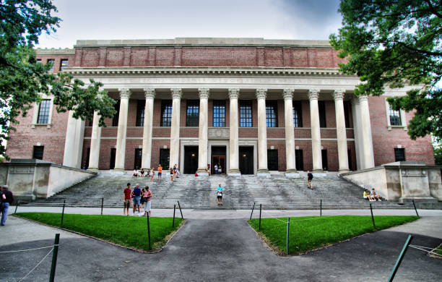
Notes:
Lib_1

Slide 7
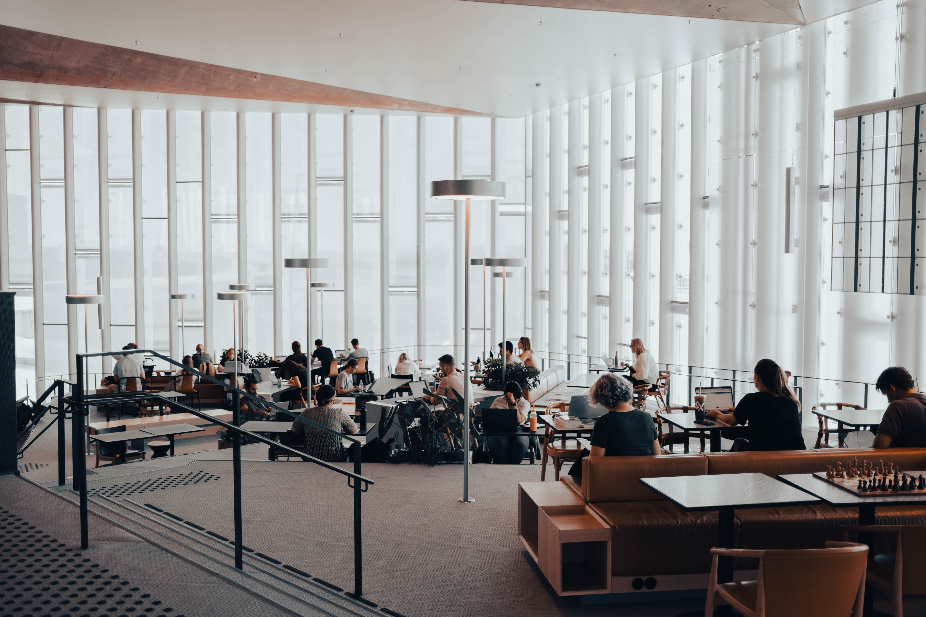
Invites accepted:
Invites rejected:
Notes:
Lib_2

Slide 8
Invites accepted:
0
Invites rejected:
20
Not interested
Not interested
Not interested
Not interested
Not interested
Not interested
Not interested
Not interested
Not interested
Not interested
Not interested
Not interested
Not interested
Not interested
Not interested
Not interested
Not interested
Not interested
Not interested
Not interested
Notes:
Lib_2

Slide 9
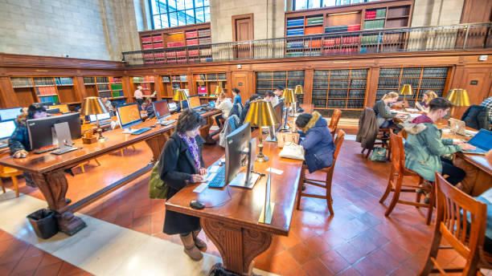
Invites accepted:
Invites rejected:
Notes:
Lib_3

Slide 10
Invites accepted:
5
Invites rejected:
5
Sure, I’ll come!
Sure, I’ll come!
Not interested
Sure, I’ll come!
Sure, I’ll come!
Not interested
Sure, I’ll come!
Not interested
Not interested
Not interested
Notes:
Lib_3

Slide 11

Invites accepted:
Invites rejected:
Notes:
Lib_4

Slide 12
Invites accepted:
5
Invites rejected:
0
Lib_4
Sure, I’ll come!
Sure, I’ll come!
Sure, I’ll come!
Sure, I’ll come!
Sure, I’ll come!
Notes:
Lib_4

Slide 13
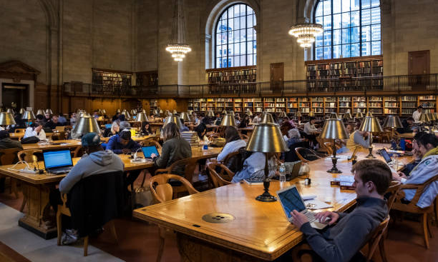
Invites accepted:
Invites rejected:
Notes:
Lib_5

Slide 14
Invites accepted:
20
Invites rejected:
0
Sure, I’ll come!
Sure, I’ll come!
Sure, I’ll come!
Sure, I’ll come!
Sure, I’ll come!
Sure, I’ll come!
Sure, I’ll come!
Sure, I’ll come!
Sure, I’ll come!
Sure, I’ll come!
Sure, I’ll come!
Sure, I’ll come!
Sure, I’ll come!
Sure, I’ll come!
Sure, I’ll come!
Sure, I’ll come!
Sure, I’ll come!
Sure, I’ll come!
Sure, I’ll come!
Notes:
Lib_5

Slide 15
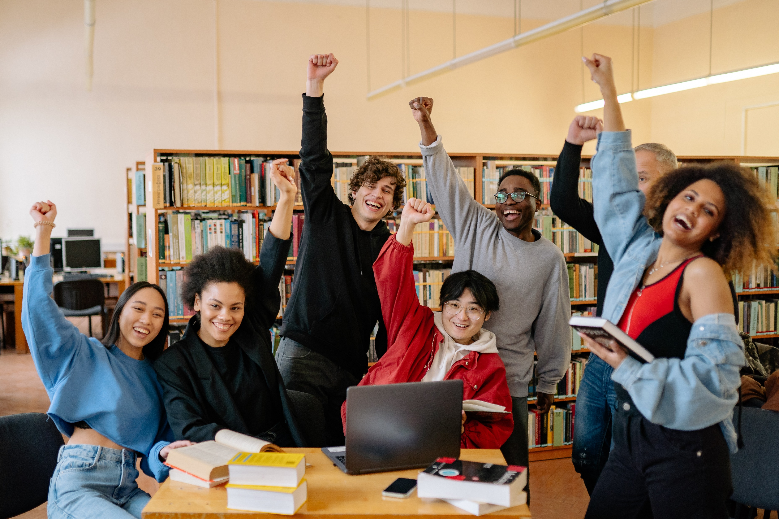
Invites accepted:
Invites rejected:
Notes:
Lib_6

Slide 16
Invites accepted:
10
Invites rejected:
0
Sure, I’ll come!
Sure, I’ll come!
Sure, I’ll come!
Sure, I’ll come!
Sure, I’ll come!
Sure, I’ll come!
Sure, I’ll come!
Sure, I’ll come!
Sure, I’ll come!
Sure, I’ll come!
Notes:
Lib_6

Slide 17
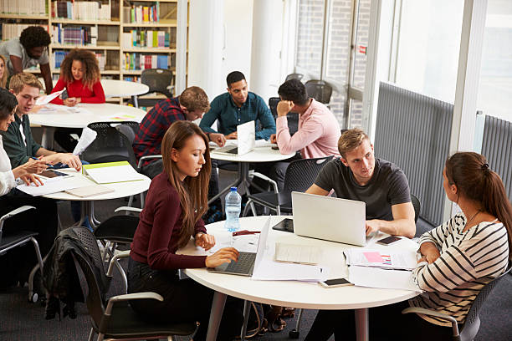
Invites accepted:
Invites rejected:
Notes:
Lib_7

Slide 18
Invites accepted:
5
Invites rejected:
10
Not interested
Sure, I’ll come!
Not interested
Sure, I’ll come!
Sure, I’ll come!
Not interested
Not interested
Not interested
Not interested
Sure, I’ll come!
Not interested
Sure, I’ll come!
Not interested
Not interested
Not interested
Notes:
Lib_7

Slide 19
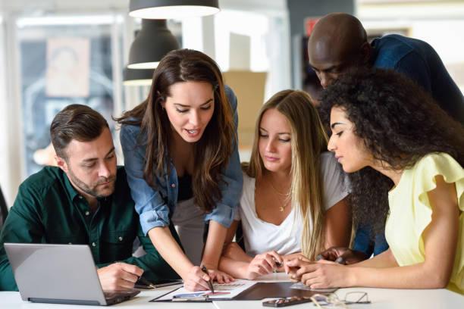
Invites accepted:
Invites rejected:
Notes:
Lib_8

Slide 20
Invites accepted:
5
Invites rejected:
0
Sure, I’ll come!
Sure, I’ll come!
Sure, I’ll come!
Sure, I’ll come!
Sure, I’ll come!
Notes:
Lib_8

Slide 21
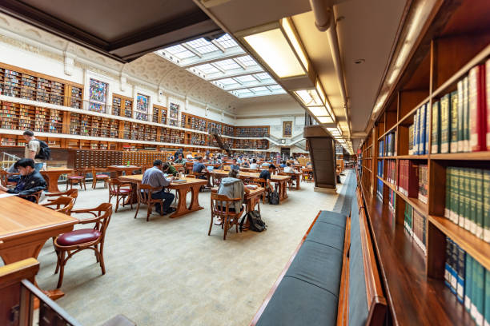
Invites accepted:
Invites rejected:
Notes:
Lib_9

Slide 22
Invites accepted:
10
Invites rejected:
10
Sure, I’ll come!
Sure, I’ll come!
Not interested
Sure, I’ll come!
Not interested
Not interested
Not interested
Not interested
Sure, I’ll come!
Sure, I’ll come!
Sure, I’ll come!
Not interested
Not interested
Sure, I’ll come!
Sure, I’ll come!
Sure, I’ll come!
Not interested
Not interested
Sure, I’ll come!
Not interested
Notes:
Lib_9

Slide 23
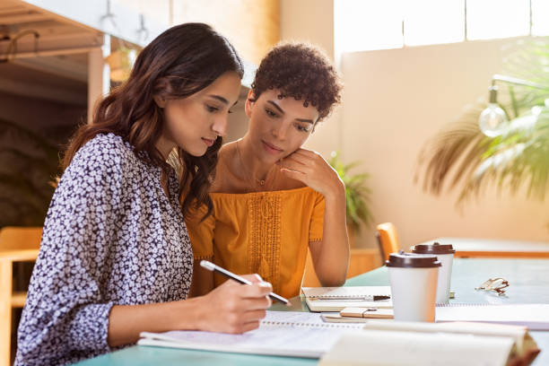
Invites accepted:
Invites rejected:
Notes:
Lib_10

Slide 24
Invites accepted:
0
Invites rejected:
2
Not interested
Not interested
Notes:
Lib_10

Slide 25
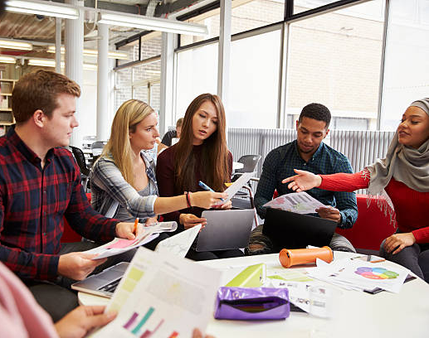
Invites accepted:
Invites rejected:
Notes:
Lib_11

Slide 26
Invites accepted:
0
Invites rejected:
5
Not interested
Not interested
Not interested
Not interested
Not interested
Notes:
Lib_11

Slide 27
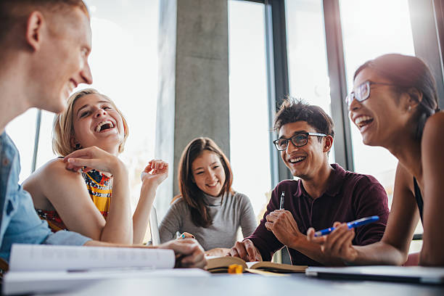
Invites accepted:
Invites rejected:
Notes:
Lib_12

Slide 28
Invites accepted:
5
Invites rejected:
0
Sure, I’ll come!
Sure, I’ll come!
Sure, I’ll come!
Sure, I’ll come!
Sure, I’ll come!
Notes:
Lib_12

Slide 29
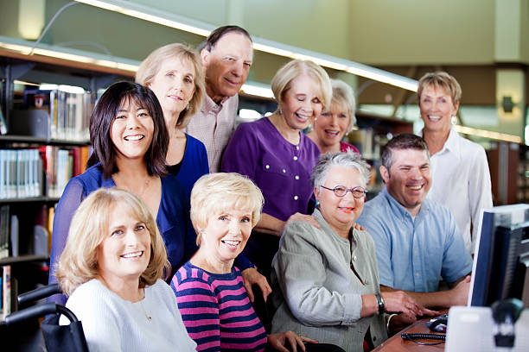
Invites accepted:
Invites rejected:
Notes:
Lib_13

Slide 30
Invites accepted:
10
Invites rejected:
0
Sure, I’ll come!
Sure, I’ll come!
Sure, I’ll come!
Sure, I’ll come!
Sure, I’ll come!
Sure, I’ll come!
Sure, I’ll come!
Sure, I’ll come!
Sure, I’ll come!
Sure, I’ll come!
Notes:
Lib_13

Slide 31
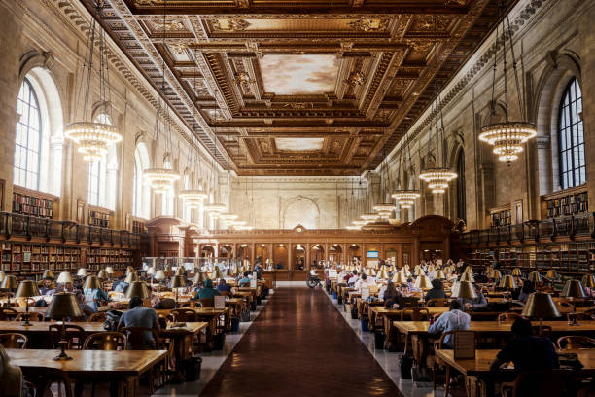
Invites accepted:
Invites rejected:
Notes:
Lib_14

Slide 32
Invites accepted:
20
Invites rejected:
0
Sure, I’ll come!
Sure, I’ll come!
Sure, I’ll come!
Sure, I’ll come!
Sure, I’ll come!
Sure, I’ll come!
Sure, I’ll come!
Sure, I’ll come!
Sure, I’ll come!
Sure, I’ll come!
Sure, I’ll come!
Sure, I’ll come!
Sure, I’ll come!
Sure, I’ll come!
Sure, I’ll come!
Sure, I’ll come!
Sure, I’ll come!
Sure, I’ll come!
Sure, I’ll come!
Sure, I’ll come!
Notes:
Lib_14

Slide 33
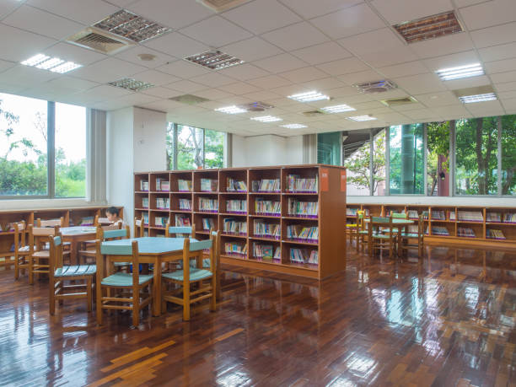
Invites accepted:
Invites rejected:
Notes:
Lib_15

Slide 34
Invites accepted:
0
Invites rejected:
0
Notes:
Lib_15

Slide 35
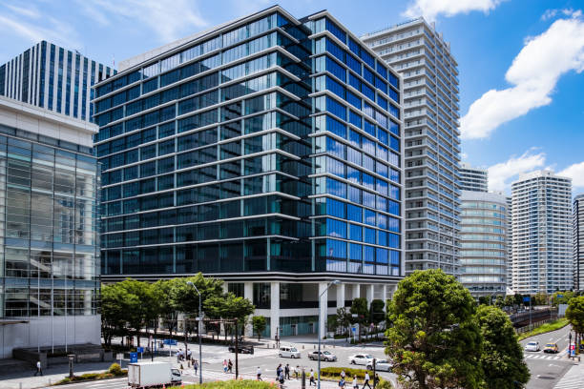
Notes:
Office_1

Slide 36
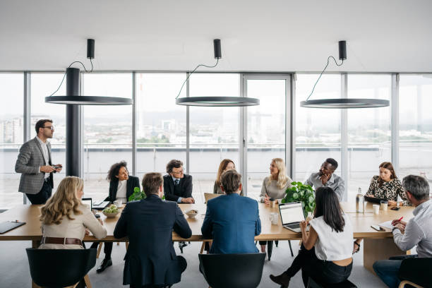
Invites accepted:
Invites rejected:
Notes:
Office_2

Slide 37
Invites accepted:
10
Invites rejected:
5
Sure, I’ll come!
Sure, I’ll come!
Not interested
Sure, I’ll come!
Sure, I’ll come!
Not interested
Not interested
Sure, I’ll come!
Sure, I’ll come!
Sure, I’ll come!
Sure, I’ll come!
Not interested
Not interested
Sure, I’ll come!
Sure, I’ll come!
Notes:
Office_2

Slide 38
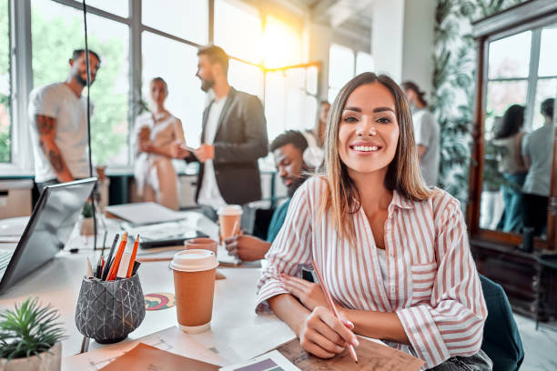
Invites accepted:
Invites rejected:
Notes:
Office_3

Slide 39
Invites accepted:
5
Invites rejected:
0
Sure, I’ll come!
Sure, I’ll come!
Sure, I’ll come!
Sure, I’ll come!
Sure, I’ll come!
Notes:
Office_3

Slide 40
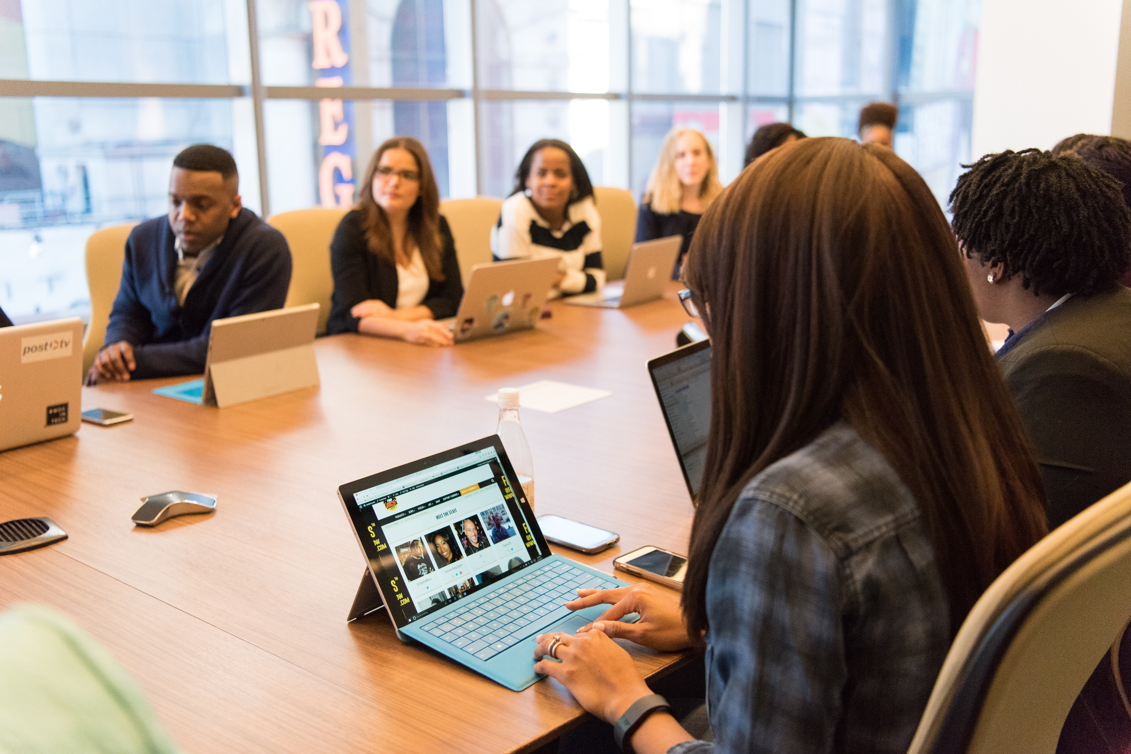
Invites accepted:
Invites rejected:
Notes:
Office_4

Slide 41
Invites accepted:
5
Invites rejected:
5
Sure, I’ll come!
Not interested
Not interested
Sure, I’ll come!
Not interested
Not interested
Not interested
Sure, I’ll come!
Sure, I’ll come!
Sure, I’ll come!
Notes:
Office_4

Slide 42
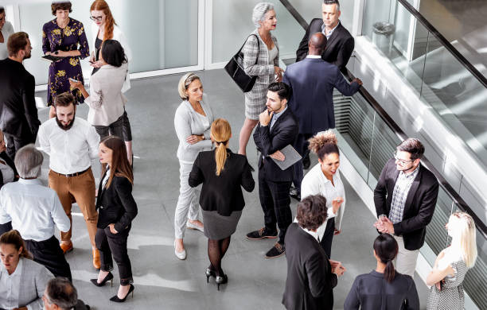
Invites accepted:
Invites rejected:
Notes:
Office_5

Slide 43
Invites accepted:
0
Invites rejected:
20
Not interested
Not interested
Not interested
Not interested
Not interested
Not interested
Not interested
Not interested
Not interested
Not interested
Not interested
Not interested
Not interested
Not interested
Not interested
Not interested
Not interested
Not interested
Not interested
Not interested
Not interested
Notes:
Office_5

Slide 44
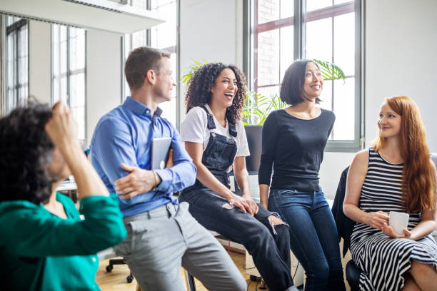
Invites accepted:
Invites rejected:
Notes:
Office_6

Slide 45
Invites accepted:
5
Invites rejected:
0
Sure, I’ll come!
Sure, I’ll come!
Sure, I’ll come!
Sure, I’ll come!
Sure, I’ll come!
Notes:
Office_6

Slide 46
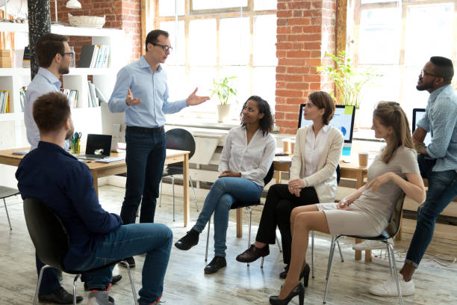
Invites accepted:
Invites rejected:
Notes:
Office_7

Slide 47
Invites accepted:
5
Invites rejected:
2
Sure, I’ll come!
Not interested
Sure, I’ll come!
Sure, I’ll come!
Sure, I’ll come!
Not interested
Sure, I’ll come!
Notes:
Office_7

Slide 48
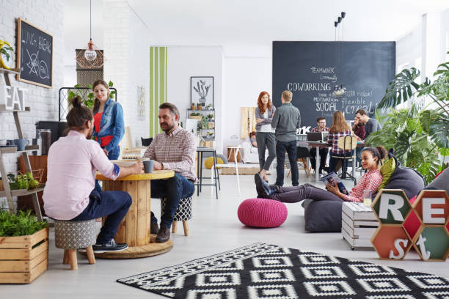
Invites accepted:
Invites rejected:
Notes:
Office_8

Slide 49
Invites accepted:
0
Invites rejected:
10
Not interested
Not interested
Not interested
Not interested
Not interested
Not interested
Not interested
Not interested
Not interested
Not interested
Notes:
Office_8

Slide 50
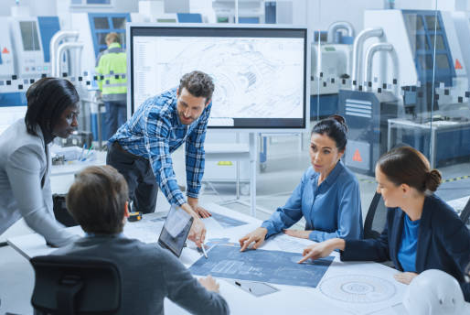
Invites accepted:
Invites rejected:
Notes:
Office_9

Slide 51
Invites accepted:
0
Invites rejected:
5
Not interested
Not interested
Not interested
Not interested
Not interested
Notes:
Office_9

Slide 52
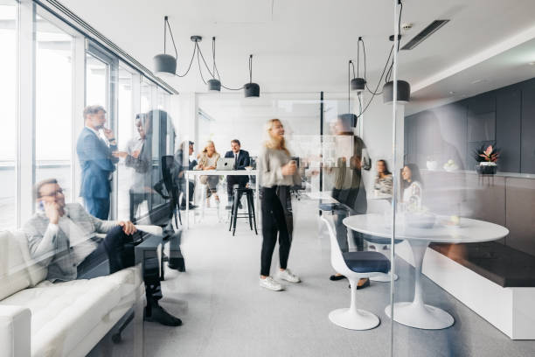
Invites accepted:
Invites rejected:
Notes:
Office_10

Slide 53
Invites accepted:
20
Invites rejected:
0
Sure, I’ll come!
Sure, I’ll come!
Sure, I’ll come!
Sure, I’ll come!
Sure, I’ll come!
Sure, I’ll come!
Sure, I’ll come!
Sure, I’ll come!
Sure, I’ll come!
Sure, I’ll come!
Sure, I’ll come!
Sure, I’ll come!
Sure, I’ll come!
Sure, I’ll come!
Sure, I’ll come!
Sure, I’ll come!
Sure, I’ll come!
Sure, I’ll come!
Sure, I’ll come!
Sure, I’ll come!
Notes:
Office_10

Slide 54
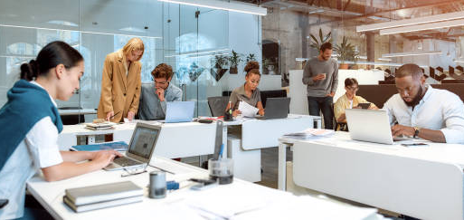
Invites accepted:
Invites rejected:
Notes:
Office_11

Slide 55
Invites accepted:
5
Invites rejected:
2
Sure, I’ll come!
Sure, I’ll come!
Not interested
Sure, I’ll come!
Sure, I’ll come!
Sure, I’ll come!
Not interested
Notes:
Office_11

Slide 56
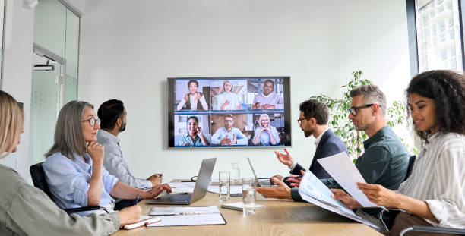
Invites accepted:
Invites rejected:
Notes:
Office_12

Slide 57
Invites accepted:
5
Invites rejected:
0
Sure, I’ll come!
Sure, I’ll come!
Sure, I’ll come!
Sure, I’ll come!
Sure, I’ll come!
Notes:
Office_12

Slide 58
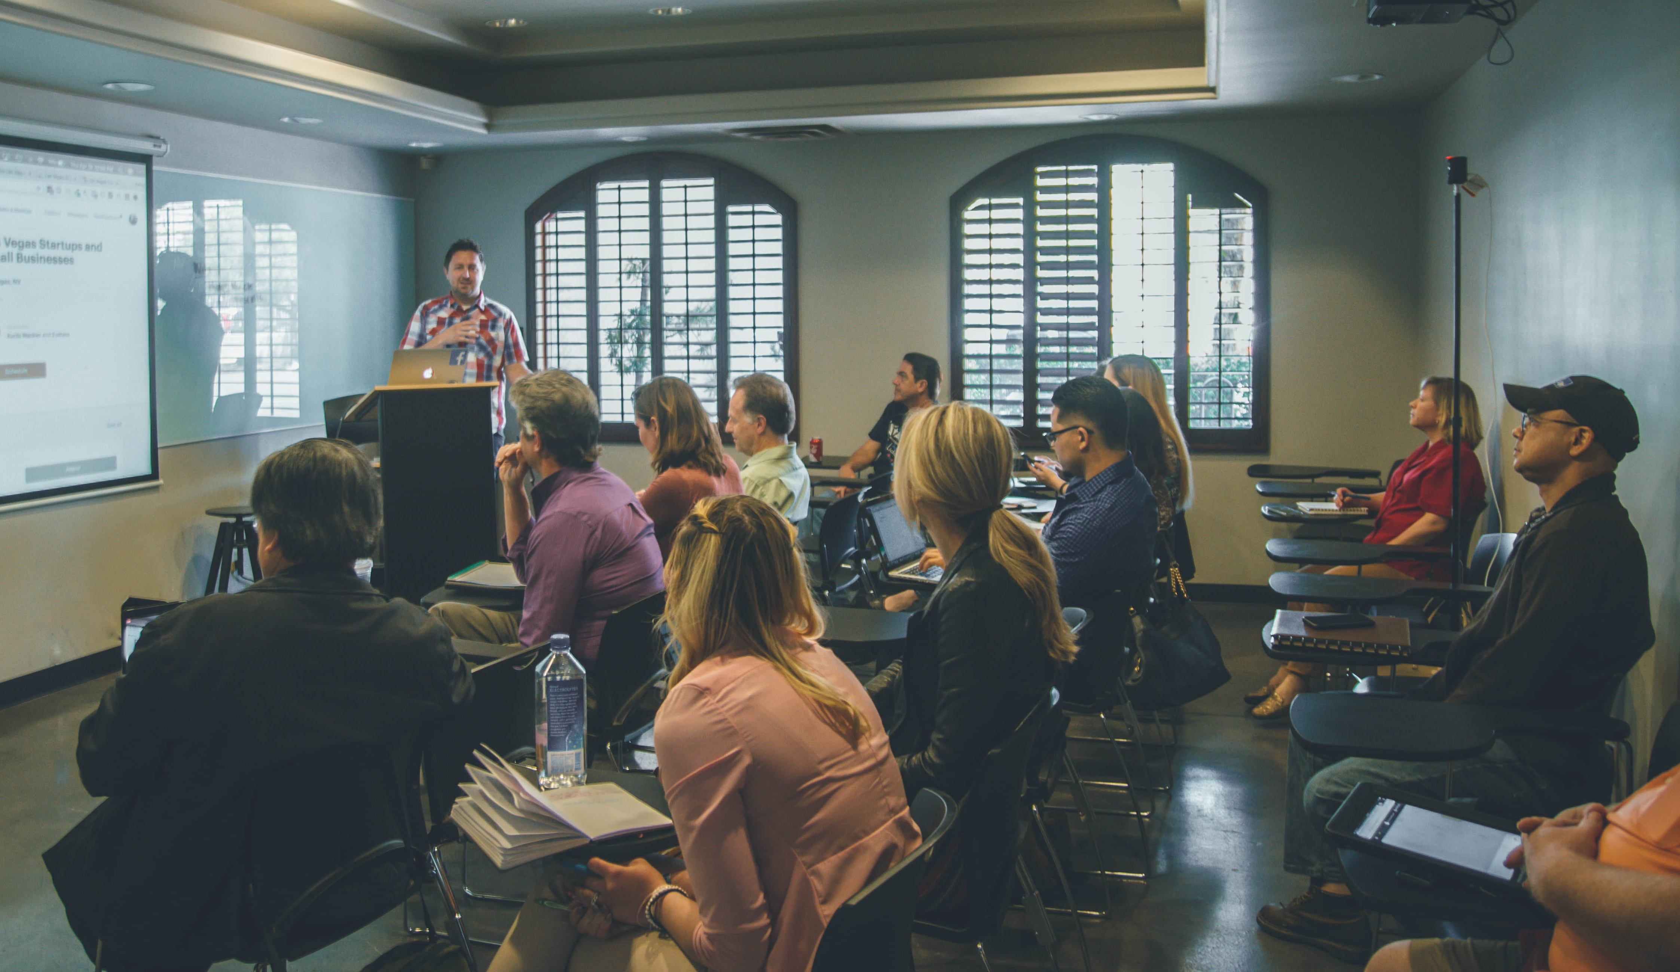
Invites accepted:
Invites rejected:
Notes:
Office_13

Slide 59
Invites accepted:
0
Invites rejected:
10
Not interested
Not interested
Not interested
Not interested
Not interested
Not interested
Not interested
Not interested
Not interested
Not interested
Notes:
Office_13

Slide 60
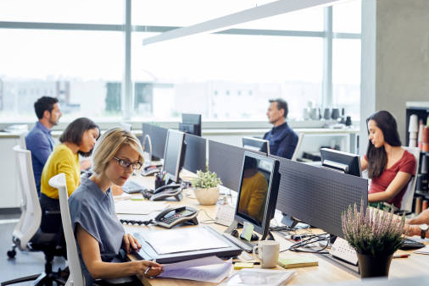
Invites accepted:
Invites rejected:
Notes:
Office_14

Slide 61
Invites accepted:
0
Invites rejected:
5
Not interested
Not interested
Not interested
Not interested
Not interested
Notes:
Office_14

Slide 62
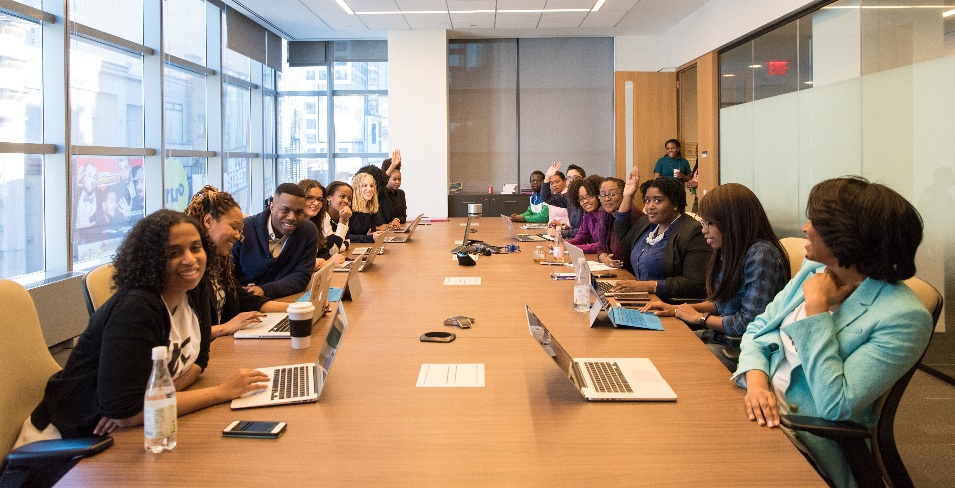
Invites accepted:
Invites rejected:
Notes:
Office_15

Slide 63
Invites accepted:
10
Invites rejected:
10
Sure, I’ll come!
Sure, I’ll come!
Not interested
Not interested
Not interested
Sure, I’ll come!
Not interested
Not interested
Not interested
Not interested
Sure, I’ll come!
Sure, I’ll come!
Sure, I’ll come!
Not interested
Sure, I’ll come!
Not interested
Sure, I’ll come!
Sure, I’ll come!
Not interested
Sure, I’ll come!
Notes:
Office_15

